Slide 1
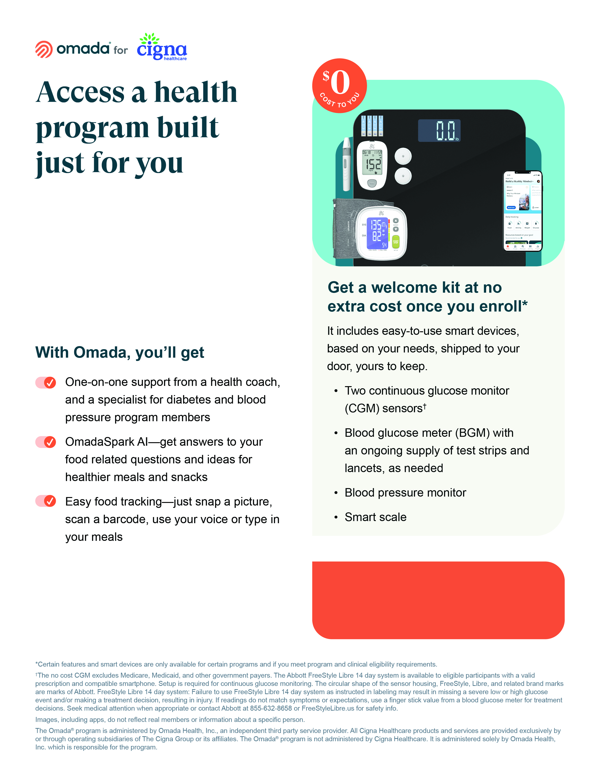
Sprinklr is offering Omada® to help people manage diabetes, lower blood pressure or lose weight with one-on-one health coaching and the tools needed to build healthy habits that stick.
The best part: the program—up to a $1,700 value—is no extra cost to you if you’re clinically eligible to enroll.
If you or your covered family members are at risk for type 2 diabetes and/or heart disease or are living with diabetes and/or high blood pressure and are accepted into the program, your Cigna Healthcare® plan will cover its full cost.
Claim My Benefit:
omadahealth.com/omadacomplete

