Slide 1





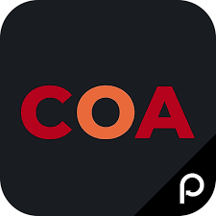
FREE COURSES FOR
Sprinklr sprinklrites
Community Online Academy (COA) is a free learning platform with thousands of classes that cover health & wellness and personal development. Classes are for adults (and kids!) – taught by the highest quality trainers and instructors.
COA is run by Perks at Work, and free to watch classes
On-demand or attend virtually any Thursday.
50+ new additions every week, from yoga to public speaking.
Learn more at https://edu.perksatwork.com or click “COA”
on the Perks at Work homepage.​
​
Favorites include Yoga, Meditation, Tai Chi, Dance,
Spanish for Beginners, and Public Speaking.
Download the free COA app to join, watch or listen to thousands of classes on the go.
Available on Apple App Store & Google Play Store

